Slide 1

Inventory Transaction Report
*Data provided should be considered CONFIDENTIAL and PROPRIETARY*
©2011-2023 MNX Global Logistics. All rights reserved.
7/24/2023 6:33 AM
Print User : selenium.automation

Slide 2
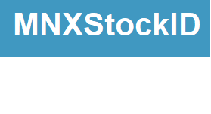
Inventory Transaction Report
*Data provided should be considered CONFIDENTIAL and PROPRIETARY*
©2011-2023 MNX Global Logistics. All rights reserved.
7/24/2023 6:33 AM
Print User : selenium.automation

